Slide 1


M.Tech Program
Advanced Industry Integrated Programs
Jointly offered by VIT University(Chennai) and LTM
Claim Sense: RAG-Based Insurance Claims Adjudication & Policy Knowledge Assistant
S K Sricharan
T-SERIES: T9984
Knowledge partner | Implementation partner

Slide 2
Claim Sense: RAG-Based Insurance Claims Adjudication
Introduction
P&C and health insurers take 5–10 days per claim because adjusters manually cross-check policy wordings, exclusion clauses and regulatory circulars — Claim Sense automates this using Retrieval-Augmented Generation (RAG).
The system ingests a claim (structured data + free-text incident description), retrieves the exact clause(s) from the customer's policy and applicable IRDAI regulations, scores fraud/anomaly risk with a trained ML model, and generates a citation-backed Approve / Investigate / Deny recommendation.
Outcome: adjudication turnaround drops from days to minutes, decisions become consistent across adjusters, and claim leakage from missed exclusions is reduced.
As a product, Claim Sense ships as an adjuster-facing dashboard (Streamlit + FastAPI) deployed on Azure (AKS), with MLflow-tracked models and CI/CD — usable as an internal claims copilot or licensed as a SaaS adjudication layer.

Slide 3
Claim Sense: RAG-Based Insurance Claims Adjudication
Objective
Ingest structured claim data and free-text incident narratives for automated triage
Build a hybrid (dense + keyword) RAG knowledge base over policy wordings, exclusion clauses and IRDAI regulatory circulars
Classify fraud/anomaly risk (Low / Medium / High) using engineered claim features and gradient-boosted models
Retrieve and cite the exact policy clause(s) that justify a decision, eliminating unsupported recommendations
Generate an explainable Approve / Investigate / Deny recommendation with inline reasoning
Provide an interactive adjuster dashboard with claim-trend and clause-citation analytics
Deploy on Azure with MLflow experiment tracking and full CI/CD (GitHub Actions/Azure DevOps → ACR → AKS)

Slide 4
Claim Sense: RAG-Based Insurance Claims Adjudication
Scope
Area | In-Scope | Out-of-Scope
Data | Synthetic policy corpus (200–500 docs) & synthetic claims (10k–50k), calibrated to real IRDAI/Kaggle/IEEE-CIS/CMS DE-SynPUF statistics | Real, identifiable insurer claim/policy data (PII- and IRDAI-restricted)
Knowledge base | RAG over synthetic policy clauses + real IRDAI circulars (chunk + embed, hybrid retrieval) | Non-insurance regulatory domains (e.g., banking, general legal)
ML risk model | Fraud/anomaly classifier (LogReg / RF / GBM / XGBoost) on structured claim features | Deep-learning image/document forensics (signature or photo tampering)
Adjudication | Citation-backed Approve / Investigate / Deny recommendation via LLM + retrieval | Fully autonomous claim payout — a human adjuster stays in the loop
Interface | Streamlit/FastAPI adjuster dashboard with analytics views | Policyholder-facing self-service claims portal
Deployment | Docker → Azure Container Registry → AKS, MLflow tracking, drift monitoring | Multi-cloud (AWS/GCP) deployment

Slide 5
Claim Sense: RAG-Based Insurance Claims Adjudication
Literature Review
# | Paper / Source (Author, Year) | Focus | Key Insight Used in Claim Sense
1 | Lewis et al., 2020 (NeurIPS) | Foundational RAG: combines parametric + non-parametric memory | Basis for grounding adjudication text in retrieved clauses to reduce hallucination
2 | Gao et al., 2023/24 (arXiv survey) | Survey: Retrieval-Augmented Generation for LLMs | Informs the hybrid dense + keyword retrieval design
3 | Reddy, 2025 (ResearchGate) | RAG + Gemini LLMs for insurance claims adjudication | Direct precedent for the RAG-based claims-adjudication pipeline
4 | Madugula & Malali, 2025 (Int. J. Sci. Res. Archive) | LLM + RAG architecture for life-insurance claims adjudication | Validates the clause-citation approach for life/health insurance lines
5 | Becker et al., 2024 | RAG for context-aware insurance claim analysis (IRB-approved study) | Confirms RAG significantly outperforms rule-based and LLM-only baselines
6 | Kumar, 2024 (cited in Becker et al.) | LLM framework for claim automation + fraud detection (fine-tuned transformer) | Anomaly-scoring approach benchmarked against Claim Sense's XGBoost classifier
7 | Pipitone & Alami, 2024 (LegalBench-RAG) | Benchmark for RAG in the legal domain | Guides evaluation of clause-citation precision and recall

Slide 6
Claim Sense: RAG-Based Insurance Claims Adjudication
Literature Review (contd.)
# | Paper / Source (Author, Year) | Focus | Key Insight Used in Claim Sense
8 | Verma et al., 2025 (ICICT) | XGBoost + Random Forest ensemble for insurance fraud detection | Baseline ensemble design for the fraud/anomaly risk classifier
9 | Ding et al., 2025 (Insurance: Math. & Economics) | PSO-optimized XGBoost with SHAP for auto-insurance fraud | Informs the explainability layer for risk-score justification
10 | Parthasarathy et al., 2023 (IJSSE) | Bayesian-optimized XGBoost for health-insurance fraud detection | Hyperparameter-tuning approach adapted for the health-claims slice
11 | Chapwanya & Gorejena, 2025 | Hybrid unsupervised ML (PCA-XGBoost-LOF + Isolation Forest) | Considered for unsupervised anomaly pre-screening before classification
12 | IJLTEMAS, 2025 | XGBoost with SMOTE for class-imbalanced auto-claim fraud detection | Confirms the oversampling strategy used for the 8–15% injected fraud rate
13 | Dimri et al., 2024 (AAAI Workshop on AI in Insurance) | LLM-based claims-handling process enhancement | Informs prompt design for adjuster-facing reasoning text

Slide 7
Claim Sense: RAG-Based Insurance Claims Adjudication
Summary of Literature
Across the 13 reviewed works, RAG consistently outperforms rule-based and LLM-only baselines for grounding domain-specific text generation, and gradient-boosted trees (XGBoost) remain the strongest tabular classifier for claims/fraud detection, especially paired with SHAP-based explainability.
Legal/insurance-specific RAG benchmarks (e.g., LegalBench-RAG) show retrieval precision — not generation fluency — is the main failure point, motivating Claim Sense's hybrid dense+keyword retrieval and clause-level citation IDs.
No published system combines clause-level RAG citation with a fraud/anomaly classifier in a single closed-loop adjudication pipeline — this integration is Claim Sense's core contribution.

Slide 8
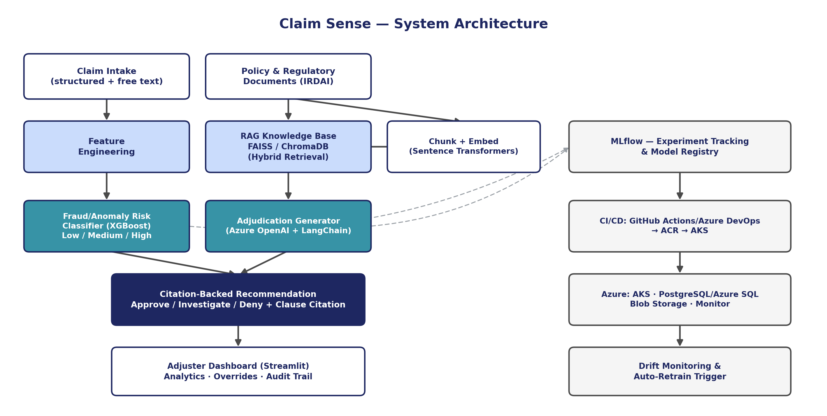
Claim Sense: RAG-Based Insurance Claims Adjudication
Architecture Diagram

Slide 9
Claim Sense: RAG-Based Insurance Claims Adjudication
Additional Information
IRDAI mandates claim settlement within specific turnaround windows under its current master circulars; Claim Sense's SLA-tracking view can flag claims at risk of breaching these regulatory timelines.
The system's audit_log and model_registry_meta tables give it explainability-by-design — every adjudication can be traced to the exact model version, feature snapshot, and cited clause used.
Because the synthetic fraud rate (8–15%) is deliberately oversampled relative to real-world sub-1% prevalence, Claim Sense reports both raw and prevalence-corrected precision/recall so business impact isn't overstated.
The RAG knowledge base doubles as a training corpus for new adjusters — the same clause-citation engine can power an internal “policy Q&A” copilot beyond claims adjudication.

Slide 10
Claim Sense: RAG-Based Insurance Claims Adjudication
Modules to Cover
Module | Key Tasks | Duration
1. Setup & Data Foundations | Provision Azure resources; build synthetic policy + claims generator; ingest real IRDAI circulars | Week 1–2
2. RAG Knowledge Base | Chunk/embed policies + circulars; build hybrid (dense+keyword) retrieval; citation resolution | Week 3–4
3. Fraud/Risk ML Model | Feature engineering; train LogReg/RF/GBM/XGBoost; MLflow tracking; register best model | Week 3–5 (parallel)
4. Adjudication Generation | Prompt design for explainable recommendation + clause citation; hallucination guardrails | Week 5–6
5. Dashboard & API | FastAPI endpoints; Streamlit adjuster dashboard; analytics views | Week 6–7
6. MLOps & Deployment | Dockerize; CI/CD pipeline; AKS deployment; drift monitoring + auto-retrain trigger | Week 7–8
7. Validation & Handover | End-to-end testing on synthetic claims; documentation; demo | Week 9

Slide 11
Claim Sense: RAG-Based Insurance Claims Adjudication
Module 1: Setup & Data Foundations
Week 1–2
Provision the Azure resource group, Azure OpenAI, ACR, AKS, PostgreSQL Flexible Server and Blob Storage
Build the synthetic policy-document generator (200–500 documents across motor, health, fire, marine, property)
Build the synthetic claims generator (10,000–50,000 records) with calibrated distributions
Ingest real, current IRDAI master circulars and annual-report statistics as-is into the knowledge base

Slide 12
Claim Sense: RAG-Based Insurance Claims Adjudication
Module 2: RAG Knowledge Base
Week 3–4
Chunk policy clauses and regulatory circulars; embed with Sentence Transformers
Stand up FAISS/ChromaDB vector store keyed to clause_id for precise citation resolution
Implement hybrid retrieval combining dense similarity search with keyword (BM25-style) search
Validate retrieval quality against a held-out set of known clause references

Slide 13
Claim Sense: RAG-Based Insurance Claims Adjudication
Module 3: Fraud/Risk ML Model
Week 3–5 (parallel)
Engineer features: claim amount vs. sum insured, tenure, days-since-policy-start, prior claim count
Train and compare Logistic Regression, Random Forest, Gradient Boosting and XGBoost
Calibrate against reference datasets (Kaggle auto-claims, IEEE-CIS) for realistic class imbalance
Track every experiment in MLflow and register the best model to the model registry

Slide 14
Claim Sense: RAG-Based Insurance Claims Adjudication
Module 4: Adjudication Generation
Week 5–6
Design prompts that force the LLM to cite only retrieved clause IDs (no free-invented citations)
Combine the fraud/risk score with retrieved clauses to produce Approve / Investigate / Deny output
Add guardrails and an LLM-as-judge consistency check against hallucinated clause references
Log every generated recommendation with its reasoning text and cited_clause_ids array

Slide 15
Claim Sense: RAG-Based Insurance Claims Adjudication
Module 5: Dashboard & API
Week 6–7
Build FastAPI endpoints for claim intake, scoring, retrieval and adjudication
Build the Streamlit adjuster dashboard: claim queue, recommendation view, override capture
Add analytics views: claim-trend charts, fraud-risk distribution, clause-citation frequency
Wire the dashboard to PostgreSQL/Azure SQL for live claim and decision data

Slide 16
Claim Sense: RAG-Based Insurance Claims Adjudication
Module 6: MLOps & Deployment
Week 7–8
Containerize the API, worker and dashboard services with Docker
Set up CI/CD via GitHub Actions/Azure DevOps: build → test → push to ACR → deploy to AKS
Configure Azure Monitor/Application Insights for logs, traces and model-serving latency
Implement drift monitoring on incoming claim features with an auto-retrain trigger

Slide 17
Claim Sense: RAG-Based Insurance Claims Adjudication
Module 7: Validation & Handover
Week 9
Run end-to-end testing on a held-out batch of synthetic claims across all product lines
Validate adjudication accuracy, clause-citation precision, and fraud-classifier metrics (AUC, F1)
Prepare documentation: data dictionary, API reference, model card, deployment runbook
Deliver a live demo of the adjuster dashboard end-to-end

